Slide 1

COURSE TITLE: ENTREPRENEURSHIP AND Technology Commercialization
Course Code: CS391
Course Instructor: Dr. Fahd S. Khan
Ghulam Ishaq Khan Institute Of Engineering Sciences and Technology

Slide 2
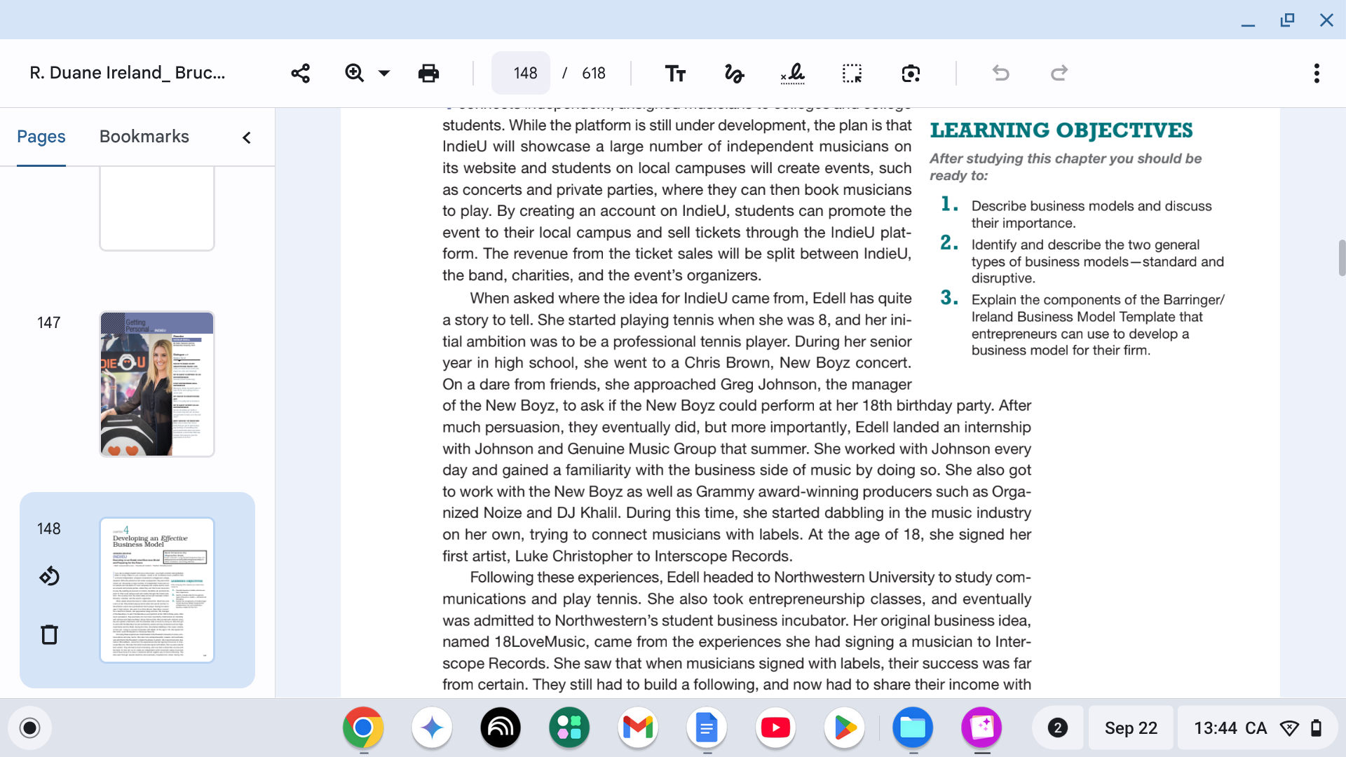

Slide 3
­A business model is a firm’s plan or recipe for how it creates, delivers, and captures value for its stakeholders.
Business models are foundational to a firm’s ability to succeed, both in the short and long term, especially when it is the first one to introduce a new product or service to customers.
Dropbox, for example, has what is referred to as a freemium business model. It offers its customers a free account with a set amount of storage space; the firm earns money by selling premium accounts with more capacity.
Dropbox could charge all of its users a monthly fee based on the amount of storage that they use, but that is not its business model. Its business model is based on the belief that by introducing users to its service through a free account, it will ultimately sign up more paid users.

Slide 4
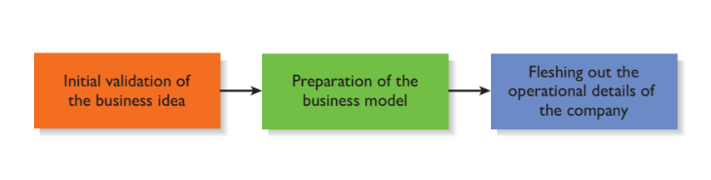
Three important elements of a firm’s business model are:
Its target market,
Its basis for differentiation, and
Its key assets.

Slide 5
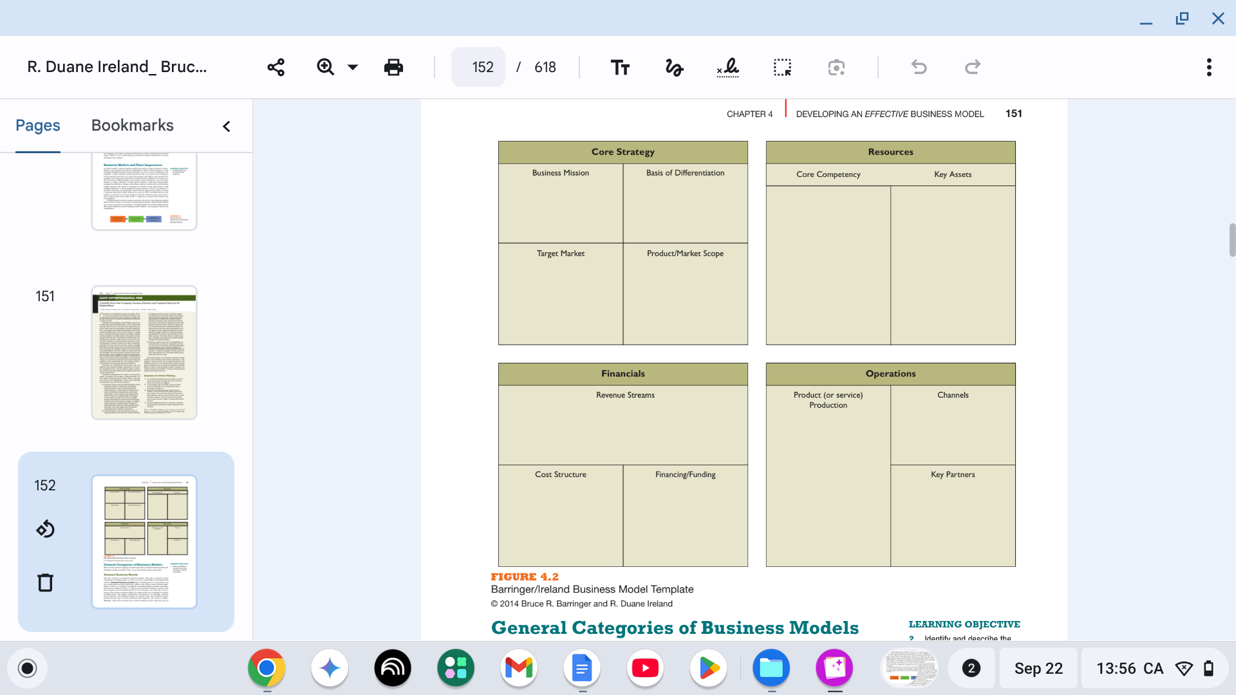

Slide 6
Standard Business Models
The first category is standard business models. This type of model is used commonly by existing firms as well as by those launching an entrepreneurial venture.
Standard business models depict existing plans or recipes firms can use to determine how they will create, deliver, and capture value for their stake holders.
For example, Amazon did not invent a new business model. It took the mail order business model and moved it online.

Slide 7
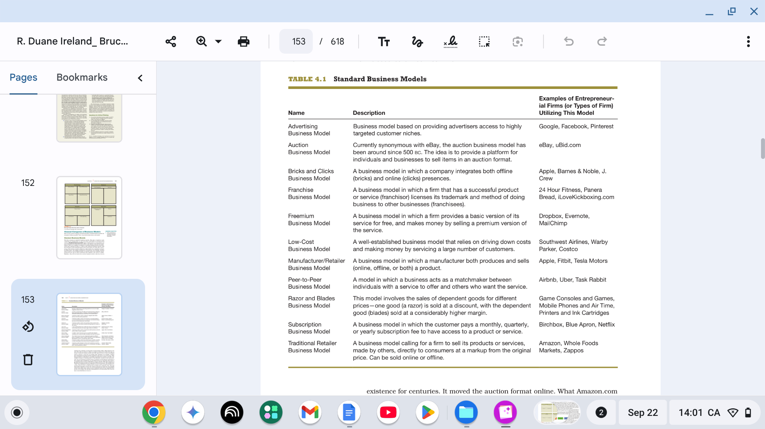

Slide 8
Disruptive Business Models
The second category of business models is disruptive business models. Disruptive business models, which are rare, are models that do not fit the profile of a standard business model, and are impactful enough that they disrupt or change the way business is conducted in an industry or an important niche within an industry.
There are many types of disruptive business models. The first type is called new market disruption. A new market disruption addresses a market that previously wasn’t served. An example is Google and its AdWords program.
The second type of disruptive business model is referred to as a low-end market disruption. Examples here include Southwest Airlines in the United States and Ryanair in Europe. Southwest created its point-to-point, low-cost, no-frills business model as an alternative to higherend service offerings provided by legacy carriers such as United and American.

Slide 9
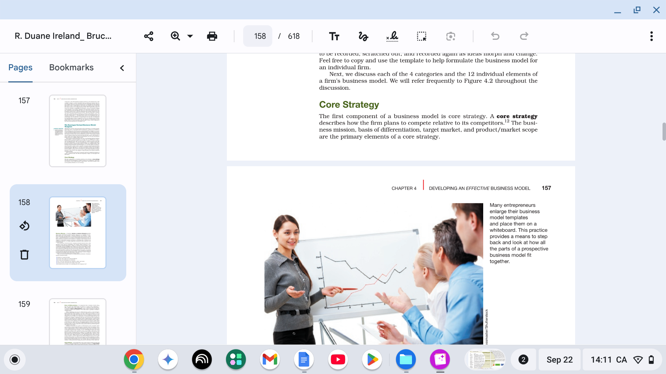
Although not everyone agrees precisely on the components of a business model, many agree that a successful business model has a common set of attributes.
These attributes are often laid out in a visual framework or template so it is easy to see the individual parts and their interrelationships.

Slide 10
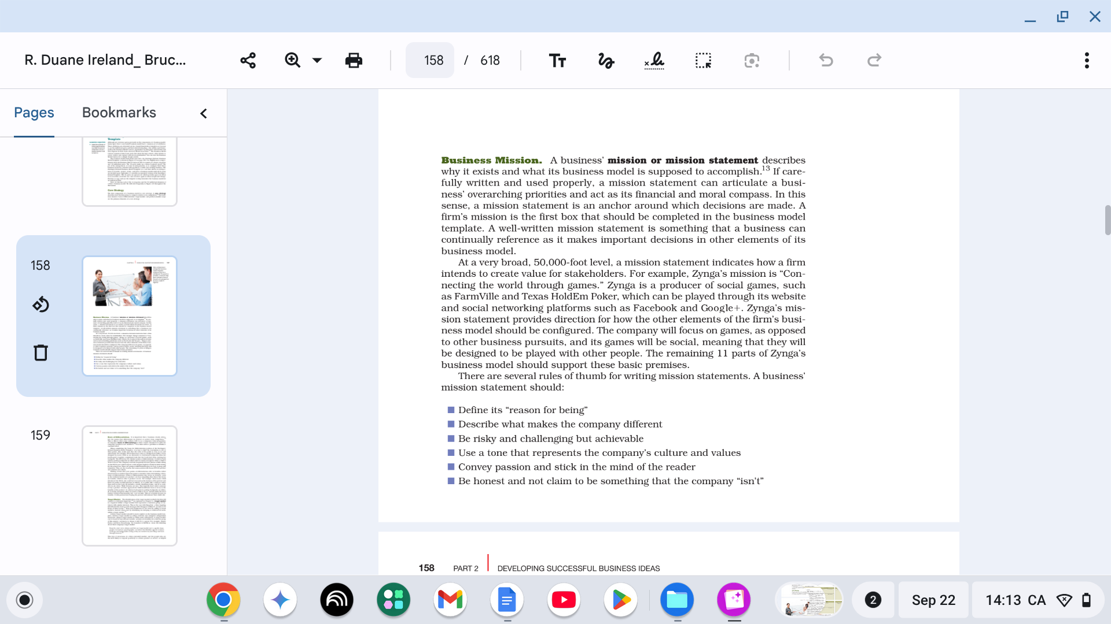

Slide 12
Basis of Differentiation
It is important that a business clearly articulate the points that differentiate its product or service from competitors.
This is akin to what some authors refer to as a company’s value proposition.
A company’s basis of differentiation is what causes consumers to pick one company’s products over another’s. It is what solves a problem or satisfies a customer need.

Slide 13
Target Market.
The identification of the target market in which the firm will compete is extremely important.
As explained in Chapter 3, a target market is a segment within a larger market that represents a narrower group of customers with similar interests.
This is the case with Snapchat, a firm targeting individuals who want to send messages that disappear within 10 seconds to 24 hours of their receipt.
Most new businesses do not start by selling to broad markets. Instead, most start by identifying an emerging or underserved niche within a larger market.

Slide 14
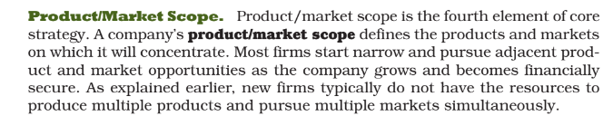
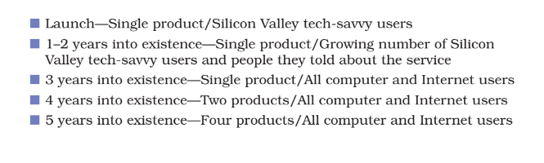

Slide 15
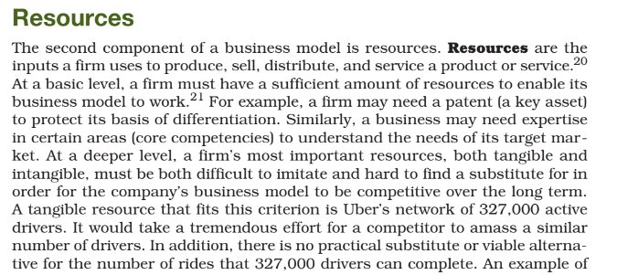

Slide 16
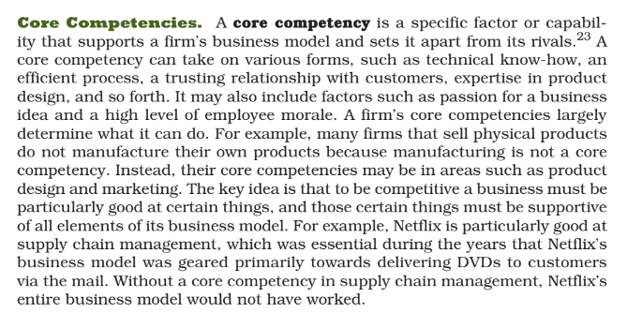

Slide 17
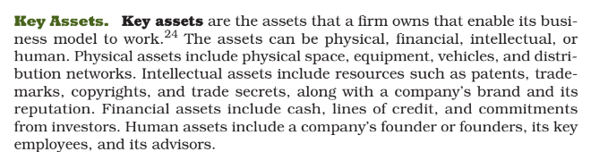

Slide 18
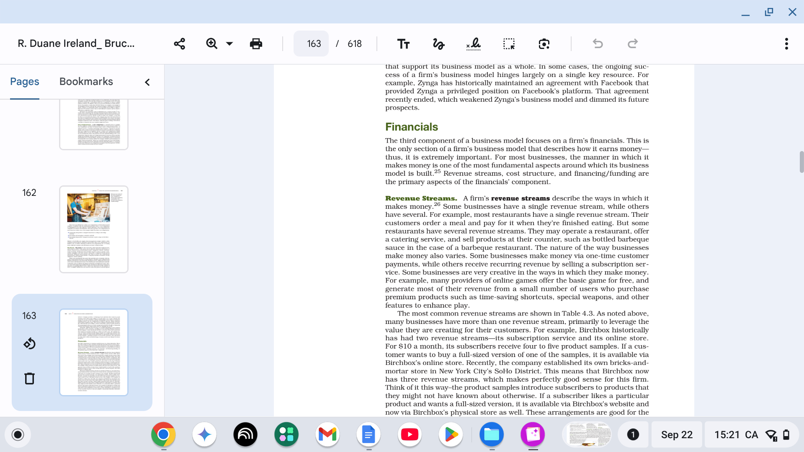

Slide 20
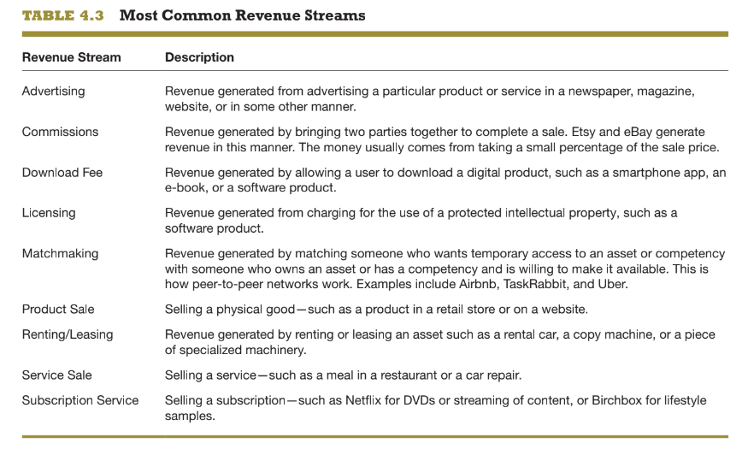

Slide 21
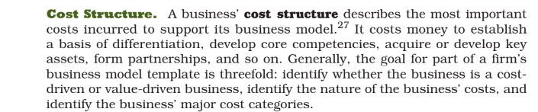
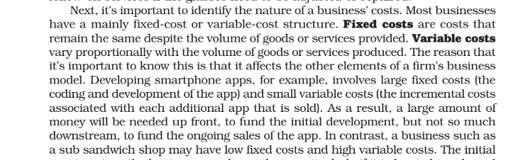

Slide 22
Financing/Funding.
Finally, many business models rely on a certain amount of financing or funding to bring their business model to life.
Most businesses incur costs prior to the time they generate revenue. think of a business such as Faraday Bikes. Prior to earning revenue, the company had to design its product, arrange for manufacturing, purchase inventory, acquire customers, and ship its product to its customers.
This sequence, which is common, typically necessitates an infusion of up-front capital for the business to be feasible. Absent the capital, the entire business model is untenable.

Slide 23
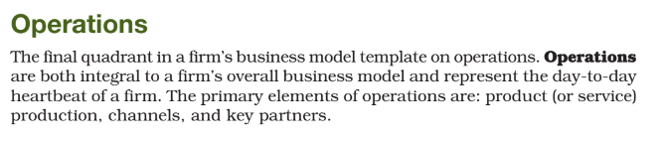

Slide 24
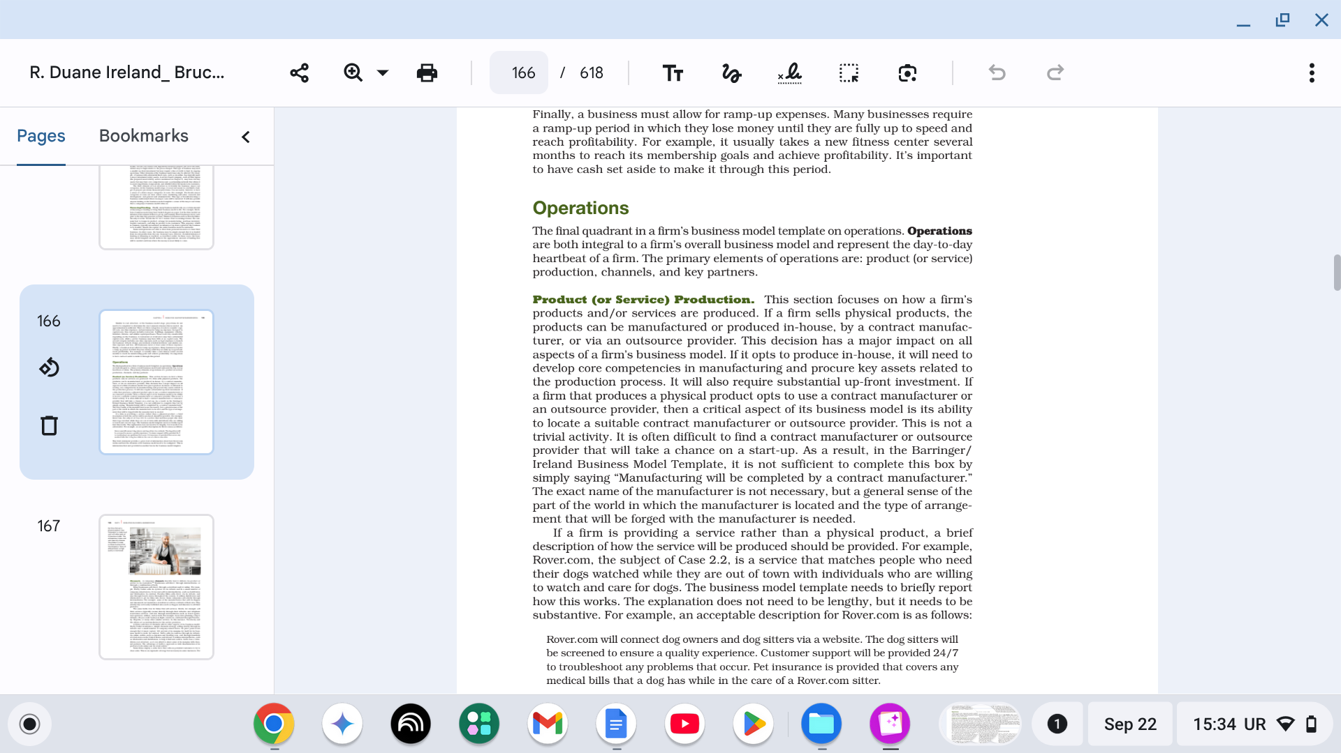

Slide 25
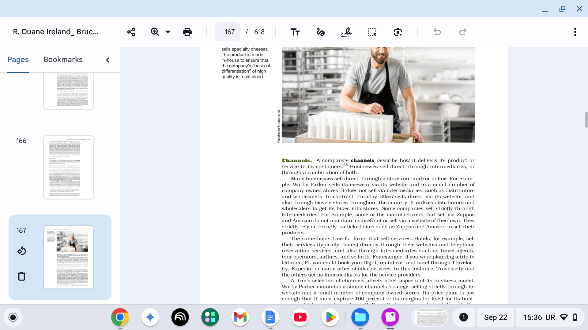

Slide 26
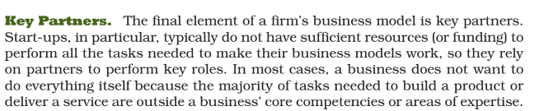
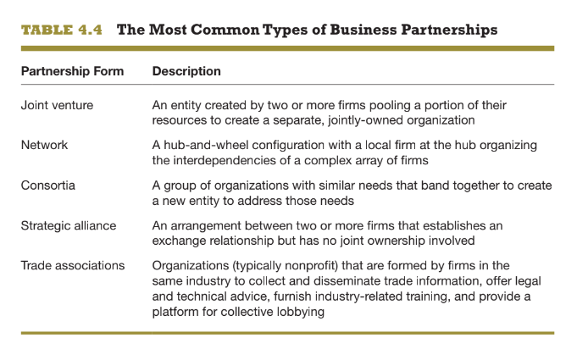

Slide 27
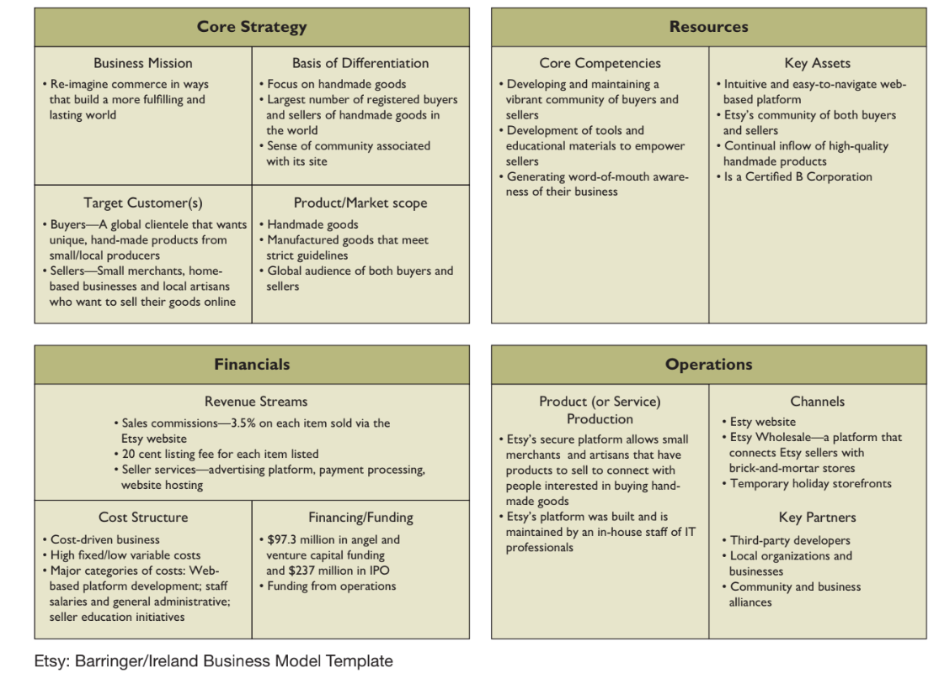

Slide 28
CHAPTER 4 CREATIVITY AND THE BUSINESS IDEA
SOURCES FOR NEW BUSINESS IDEAS
Previous Employment
Hobbies
Intentional Search
Accidental Invention or Discovery

Slide 29
CHAPTER 4 CREATIVITY AND THE BUSINESS IDEA
SOURCES FOR NEW BUSINESS IDEAS
TRENDS(DEMANDS OR NEED AT A SPECIFIC TIME)
Wearable trend
Green trend(ENVIRONMENT RELATED, CROPS, RECYCLING, PAPERS FROM TREES FOR CLEAN ENVIRONMENT)
Payments(ATM, ONLINE EASYPAISA NAYAPAY ETC)
Maker trend
Mobile trend ( Industry exceeded $7.8 billion)
Health trends(DIET KETO DIET PHYSICAL FITNESS YOGA THERAPY MENTAL THERAPY FITTESS APPS SMART WATCHES)
The Internet of things (by 2020, more than 26 billion devices)

Slide 30
CHAPTER 4 CREATIVITY AND THE BUSINESS IDEA
SOURCES FOR NEW BUSINESS IDEAS
Existing Products and Services ( Sam Walton)(ATMS COMPANY AND THEN ANOTHER COMPANY CAME AND INTRODUCE ONLINE PAYMENT)
Distribution Channels (THEY KNOW ABOUT MARKET AND CUSTOMER DEMANS)
Research and Development(GOOGLE FACEBOOK AMAZON ETC COMPANIES)
IDEAS FROM CONSUMERS

Slide 31
CHAPTER 4 CREATIVITY AND THE BUSINESS IDEA
Needs:
Human needs are states of felt deprivation. (Physical needs for food, clothing, warmth, and safety)
Wants:
Want are the form taken by human needs as they are shaped by culture and individual personality.
People have almost unlimited wants but limited resources.
They want to choose products that provide the most value and satisfaction for their money.
Demands:
When backed by buying power, wants become demands.
Consumers view products as bundles of benefits and choose products that give them the best bundle for their money.

Slide 32
CHAPTER 4 CREATIVITY AND THE BUSINESS IDEA
Market Segmentation
The process of dividing the market into subgroups of similar customers.
Market Segment
Subgroups of people that share similarities which can be used for more efficient seller/buyer relationship.

Slide 33
CHAPTER 4 CREATIVITY AND THE BUSINESS IDEA
How to access segments?
Common used criteria segments should be:
Substantial
Accessible
Actionable
Differentiable
Measurable

Slide 34
CHAPTER 4 CREATIVITY AND THE BUSINESS IDEA
Target Market
Subgroup that present greatest opportunity for targeting.
How to select segments for targeting?
Need to take into account:
Available company resources
Segment growth potential
Segment profitability
Competitive environment
Company long term objective

Slide 35
CHAPTER 4 CREATIVITY AND THE BUSINESS IDEA
METHODS OF GENERATING IDEAS
Focused Group
Brainstorming
Reverse brainstorming
Brainwriting
Gordon method
Checklist method
Free association

Slide 36
CHAPTER 4 CREATIVITY AND THE BUSINESS IDEA
METHODS OF GENERATING IDEAS
Forced relationships
Collective notebook method
Attribute listing method
Big-dream approach
Parameter analysis

Slide 37
CHAPTER 4 CREATIVITY AND THE BUSINESS IDEA
METHODS OF GENERATING IDEAS
Focused Group
Groups of individuals providing information in a structured format.

Slide 38
Thank You

